Slide 1


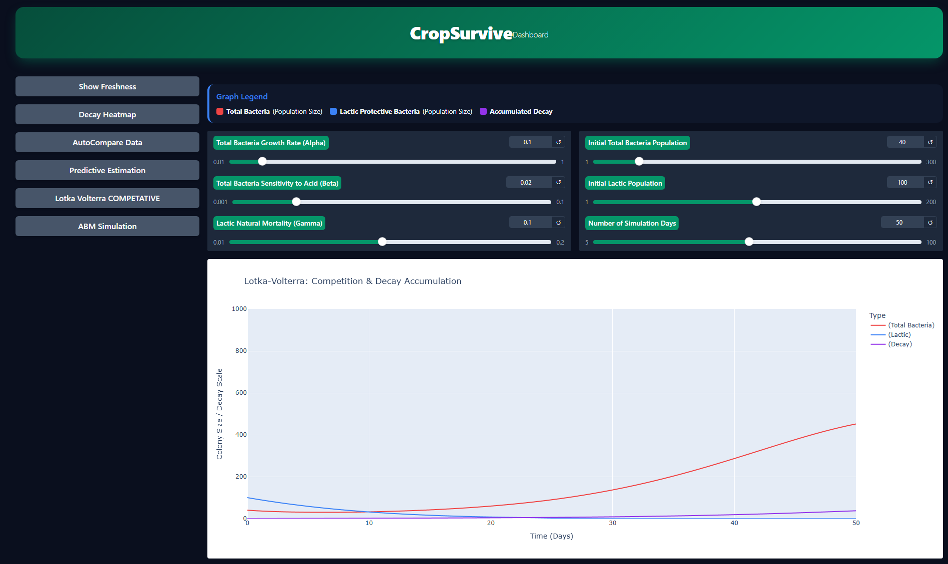
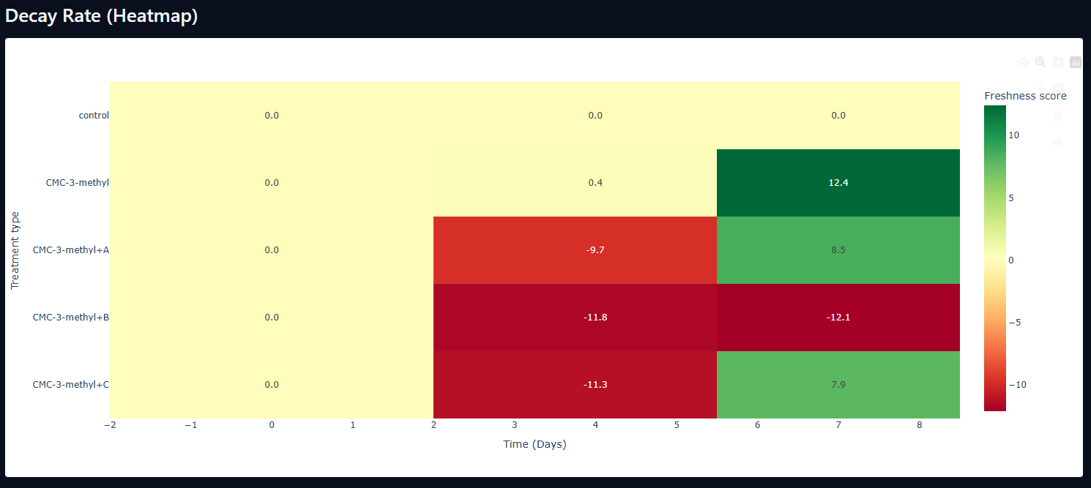
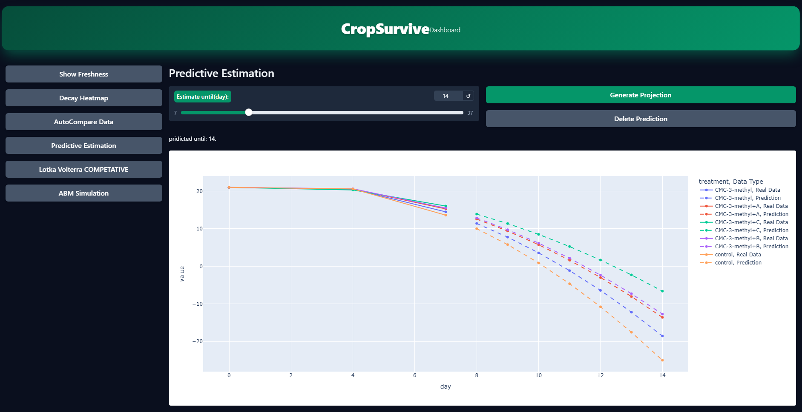
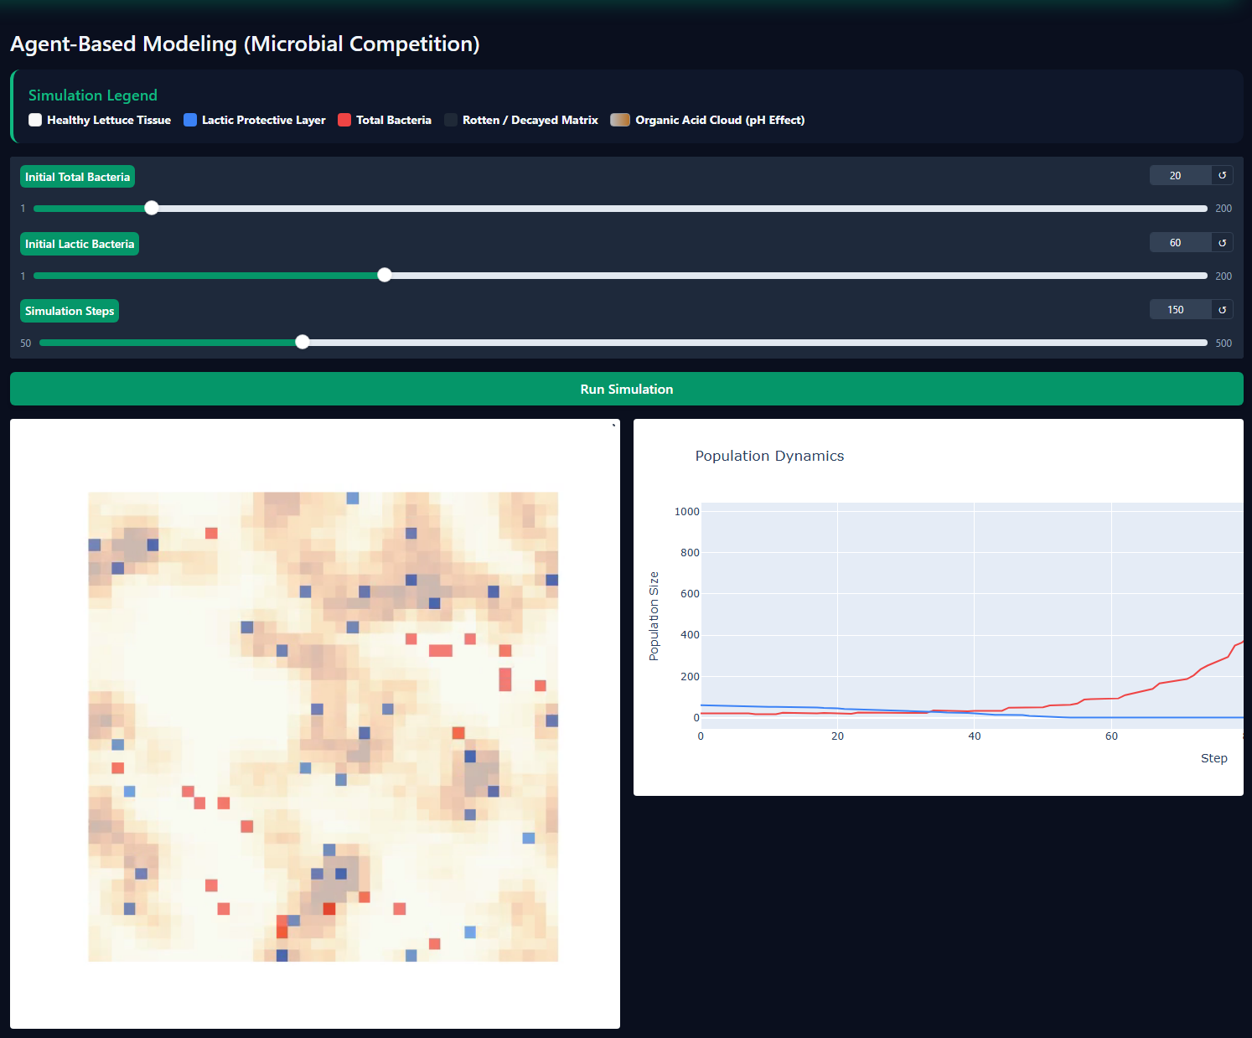
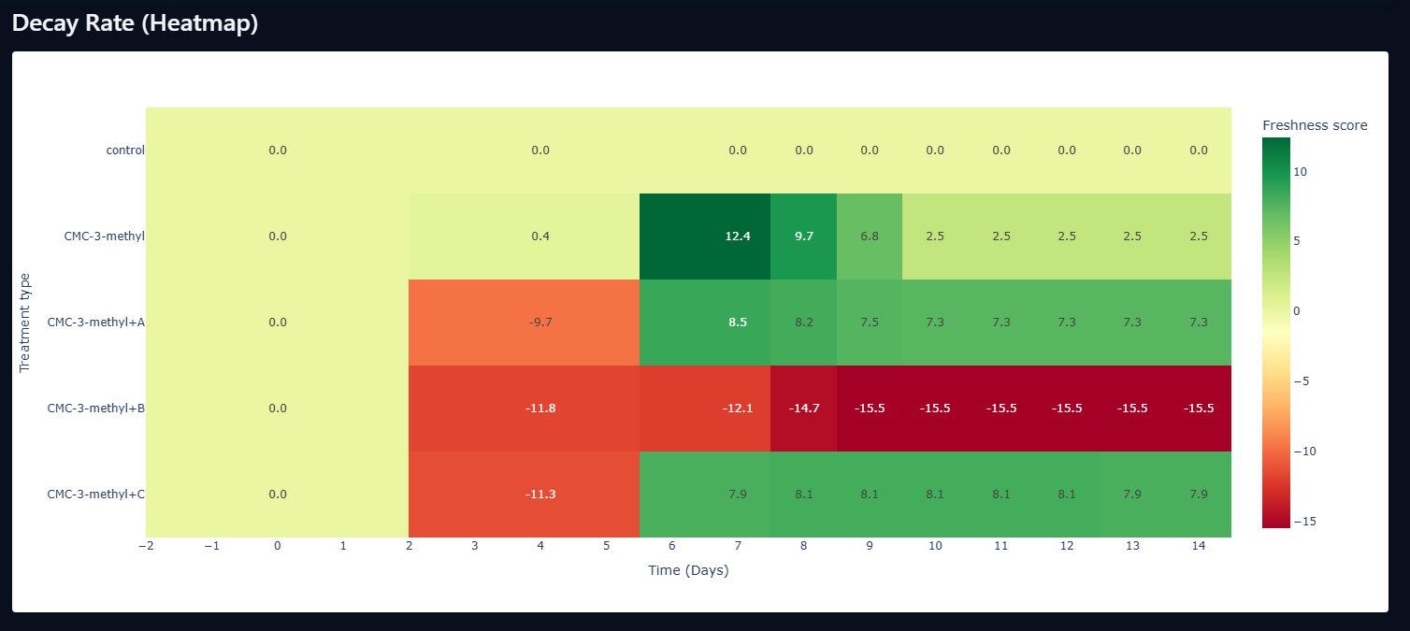
CROP SURVIVE
Crop Survive: Engineering Platform for Shelf-Life Prediction
Developed & Presented by: Yoni Grinberg
Supervisor: Dr. Unkelos Shpigel Naomi
RESEARCH QUESTIONS
Hypothesis 1 (Inhibition): Will A higher concentration of protective lactic acid bacteria inhibit the replication of spoilage microflora, thereby reducing the overall decay rate of the lettuce?
Hypothesis 2 (Kinetics): Will the overall rate of lettuce tissue decay will accelerate over time as a direct consequence of the natural mortality and depletion of the protective lactic bacteria?
METHOD — STUDY DESIGN
Controlled experiment:
Formulations: Evaluation of 4 distinct bio-coating formulations
Timeline: Post-harvest study duration spanning 21 days
Data Acquisition: Data Collected on dependent variables
Analytical Framework: Integration of Principal Component Analysis (PCA), competitive Lotka-Volterra and spatial Agent-Based Modeling (ABM) to synthesize and validate decay kinetics
CONCLUSIONS & RECOMMENDATIONS
Active bio-coating formulation CMC-3-methyl+C exhibits superior decay mitigation, yielding outstanding preservation () of structural integrity compared to the untreated control group by Day 7
Deterministic curve-fitting utilizing 2nd-degree polynomial regression provides highly stable and robust predictive trends on low-density/sparse laboratory datasets (Days 0, 4, 7) without overfitting
The competitive Lotka-Volterra ODE solver and spatial Agent-Based Modeling (ABM) successfully replicate post-harvest tissue decay "tipping points," providing accurate qualitative validation for experimental observations
PRACTICAL RECOMMENDATIONS
Prioritize microbial-active bio-coatings (CMC-3-methyl+C) to significantly extend commercial shipping windows. | Deploy deterministic fitting algorithms rather than complex neural networks when modeling low-density laboratory datasets.
Embed real-time decay sliders in grower-facing logistics software to dynamically estimate produce shipping lifespans. | Leverage spatial cellular modeling (ABM) to simulate uneven decay distribution across bulk storage containers.
Limitations: Low-density sampling intervals (Days 0, 4, 7) · Evaluation restricted to Romaine Lettuce tissue · Constant laboratory storage conditions rather than variable real-world shipping temperature/humidity stress

